Slide 1
Data Structures
ICT-1211
Information and Communication Technology
Lecture-12
Date:

Slide 2
Linked Lists

Slide 3
LINKED LISTS: Insertion Algorithms
Insertion Algorithms in Linked List
Inserting element at the Beginning of a Linked List
Inserting element after a Given node of a Linked List
Inserting element into a sorted Linked List.

Slide 4
LINKED LISTS: Insertion Algorithms
Algorithms which inserts nodes into linked lists come up in various situations :
  Inserts a node at the beginning of the list,
  Inserts a node after the node with a given location, and
  Inserts a node into a sorted list.
All the algorithms:
  assume that linked list is in memory in the form
  LIST(INFO, LINK, START, AVAIL)
  Have a variable ITEM which contains the new information to be added to the list.

Slide 5
LINKED LISTS: Insertion Algorithms
Since all the insertion algorithm will use a node in the AVAIL list, all of the algorithm will include the following steps:
  Checking to see if space is available in the AVAIL list. If not, that is,
  If AVAIL=NULL, then the algorithm will print the message
  OVERFLOW.
  Removing the first node from the AVAIL list. Using the variable NEW to keep track of the location of the new node.
  NEW:=AVAIL,
  AVAIL:=LINK[AVAIL]
  Copying new information into the new node. i.e.,
  INFO[NEW]=ITEM

Slide 6
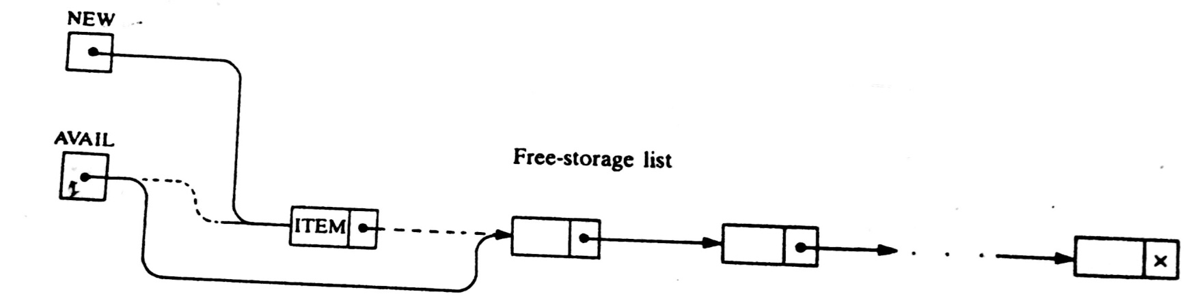
LINKED LISTS: Insertion Algorithms

Slide 7
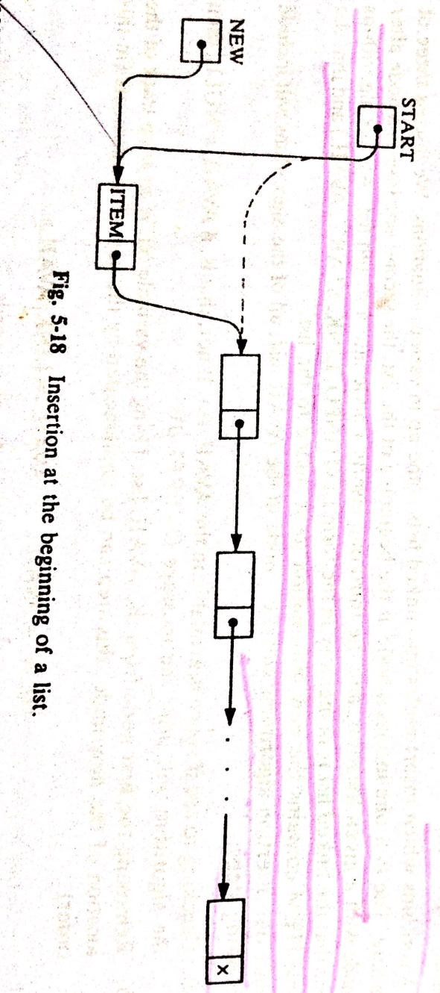
LINKED LISTS: Inserting at the Beginning of a list
[Remove first node from AVAIL list.]
Set NEW:=AVAIL and AVAIL:=LINK[AVAIL]

Slide 8
LINKED LISTS: Inserting at the Beginning ….ALG
INSFIRST (INFO, LINK, START, AVAIL,ITEM)
[OVERFLOW?] If AVAIL=NULL, then Write: OVERFLOW, and Exit.
[Remove first node from AVAIL list.]
Set NEW:=AVAIL and AVAIL:=LINK[AVAIL]
Set INFO[NEW]:=ITEM.[Copies new data into new node.]
Set LINK[NEW]:=START.[New Node now points to original first node.]
Set START:=NEW. [Change START so it points to the new node.]
Exit.

Slide 9
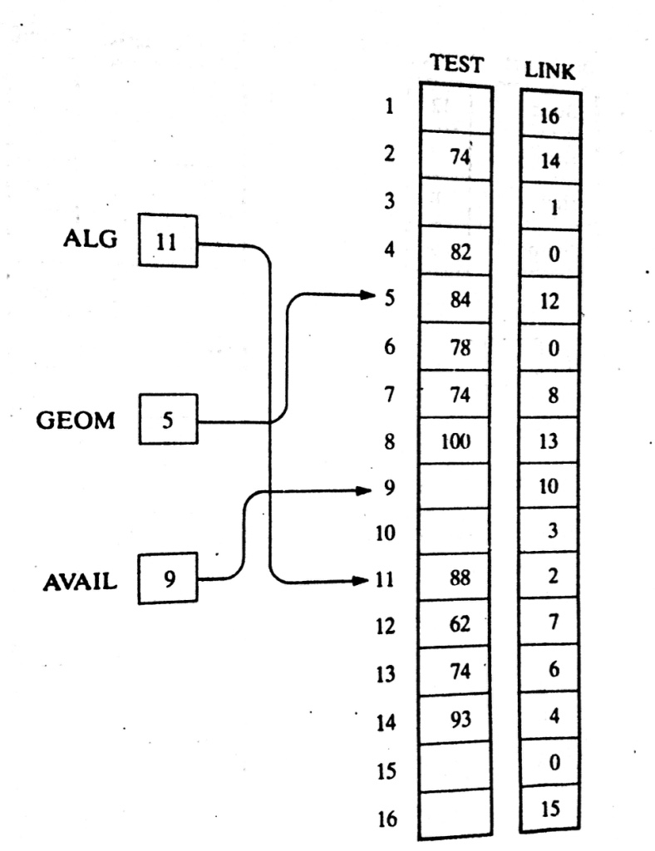
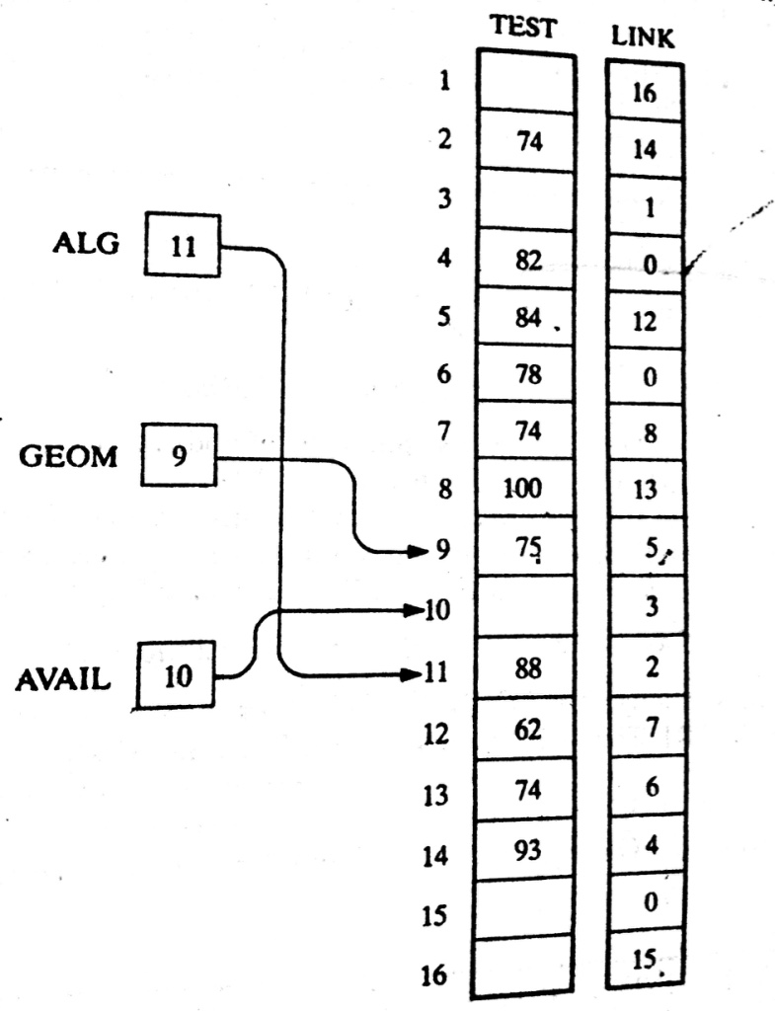
LINKED LISTS: Inserting at the Beginning ….Exmp

Slide 10
LINKED LISTS: Inserting after a given node
INSLOC (INFO, LINK, START, AVAIL, LOC, ITEM)
[OVERFLOW?] If AVAIL=NULL, then Write: OVERFLOW, and Exit.
[Remove first node from AVAIL list.]
Set NEW:=AVAIL and AVAIL:=LINK[AVAIL]
Set INFO[NEW]:=ITEM.[Copies new data into new node.]
If LOC=NULL, then [Insert as first node.]
  Set LINK[NEW]:=START and START:=NEW.
  Else: [Insert after node with location LOC.]
  Set LINK[NEW]:=LINK[LOC] and LINK[LOC]:=NEW.
  [END if If structure.]
Exit.

Slide 11
Thank you……

